Slide 1

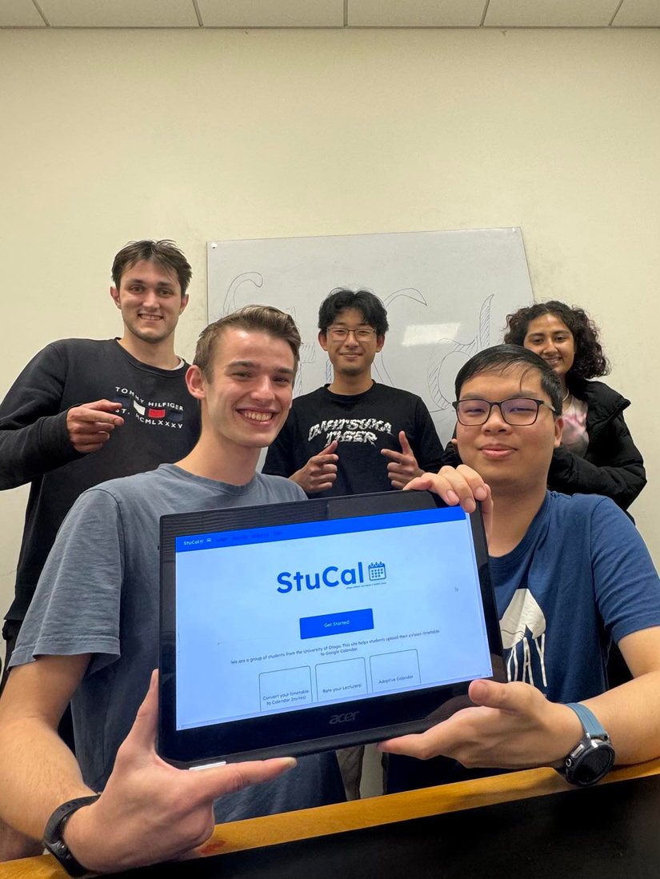
The StuCal Team
Introducing the team behind StuCal
Sam Bugden
James Robiony-Rogers
Yuki Yoshiyasu
Cyrus Yam
Shreya Das
Learn More
01

Slide 2

The Problem
Our motivation behind StuCal stemmed from the inconvenience of regularly checking our eVision timetables for our next classes.
Recognising this tedious process, we came up with the idea of integrating our class schedules into our everyday calendar apps.
02
Notes:
Cyrus
- SO, imagine this right?
- You have just been course approved and are looking at your eVision timetable.
- You are looking through it and you have a day free, good, if you don't, that sucks. You probably would want to sync it to your personal calendar, but there is no easy way to do it other than manually putting in the events for your lectures and tutorials.
- Plus no customisation, yuck.
- You painstakingly have to add all the classes into your calendar, becoming frustrated as you have to consider things such as public holidays and mid sem break. AH.
- What if there was a way to solve this issue altogether?
- INTRODUCING STUCAL, THE SOLUTION TO ALL YOUR ISSUES FOR SCHEDULING!

Slide 3


Home
Service
About Us
Contact
03
Notes:
SAM
- Introducing StuCal
- Web application that allows users to Import EVision to StuCal
- Nice looking, functional calendar that you can print out or view on your phone.
- StuCal can detect when you have gaps in your calendar and suggests healthy habits like exercising or study sessions.
- If you have multiple friends on StuCal, you can combine your timetables to see when the whole group is free to organise a study session or meet up.
- We are also adding small features like adding the otago key dates and progress bars to the next semester break

Slide 4









User Stories
A Day in the Life of Bob
5
3
5
2
6
6
2
7
8
Learn More
04
Effort required for feature. 1-10
Notes:
SAM
Bob wakes up, sees his StuCal Calendar printed out on the wall.
It is a nice looking customised calendar of his eVision events for the day.
He notices that he has a group study session today and he is running late so he checks the weather on his StuCal app before heading out the door.
---
YUKI
The StuCal app has a clean design and tells bob where to go and what time each event is.
Bob arrives at the group study session. Where StuCal has already taken into account when each person in the group is free.
---
JAMES
After the meeting StuCal prompts Bob to get some exercise in before his next lecture. He goes for a run.
In-between lectures, StuCal suggests a study session based on the time he has free.
--
Shreya
Finishing his lectures for the day, Bob makes his way home. He is reminded by StuCal that it is the last day to add your semester papers at Otago integrating Otago's key dates.
Before going to bed, Bob checks his "coming up" section on the app to see what has tomorrow.

Slide 5
User Stories
01 | As a busy university student, I want to sync my class timetable with my personal calendar (Google, Apple, etc) so I can stay organised. 4
02 | As a student, I want the app to automatically update my calendar with any changes to my timetable or exam schedule to avoid confusion. 9
03 | As a student, I want the web app to provide insights into potential timetable clashes (private and uni) so I can make adjustments in advance. 7
04 | As a student, I want the app to show me key university dates, so I know when the semester breaks are. 2
05 | As a student, I want to be able to search upcoming key dates, so I know when to plan my holidays. 5
06 | As a student preparing for exams, I want to sync my exam timetable with my personal calendar so I can plan my study schedule effectively prior to exams. 7
07 | As a student, I want to customise the look of my calendar to feel more specific and personalised to me. (Adding icons to papers) 6
08 | As a student I want to use a streamlined, simple aesthetic application. 6
09 | As a student I want to be able to view the weather forecast so I know when it rains. 5
10 | As a student, I want to be able to share events with my peers, so I can plan hangouts easily. 7
11 | As a student, I want the web app to save templates so I don't have to create recurring events from scratch. 6
12 | As a student aiming to excel academically, I want the app to suggest study sessions based on my timetable and exam schedule to optimise my learning. 7
13 | As a group of students taking the same paper, we want suggestions for group study sessions where everyone is free. 6
14 | As a student I want to be able to create healthy habits based on available times in my calendar. 4
15 | As a busy student, I want a streamlined view (by agenda / by month etc)to make providing feedback as quick as possible. 6
16 | As a student, I want to print out a physical calendar with all my classes so it's more accessible. 6
17 | As a student with a hectic schedule, I want the app to send me reminders before each class and exam so I can stay on top of my academic commitments. 8
05
Notes:
Bob wakes up, sees his StuCal Calendar printed out on the wall. It is a customised calendar of his eVision events for the day.
He notices that he has a group study session today and he is running late so he checks the weather on his StuCal app before heading out the door.
The StuCal app has a clean design and tells bob where to go and what time each event is.
Bob arrives at the group study session. The session was made by StuCal taking into consideration when each person in the group is free.
After the meeting StuCal prompts Bob to get some exercise in before his next lecture. He goes for a run.
In-between lectures, StuCal suggests a study session based on the time he has free.
Finishing his lectures for the day, Bob makes his way home. He is reminded by StuCal that it is the last day to add your semester papers at Otago.
Before going to bed, Bob checks his "coming up" section on the app to see what has tomorrow.

Slide 6


Legal
Data Privacy
All data will be stored securely on our Firebase Database
A disclaimer will be shown that we are storing this data.
Free Resources
We are using free, open source Images and Icons.
06
Notes:
Shreya
- I will be introducing our feaibility study that shows the viability of us to be able to deliver a product successfully.
- We have thought about the legal and ethical implications of our design.
- The two aspects that we have taken into consideration is the data privacy and the free resources.
- When it comes to Data privacy, we will using a secure database, which is Firebase that has built in security for managing log in systems when connecting to APIs for log ins from Google and Microsoft authentications.
- We also will have legal privacy notices that disclaim what and where we will use the user's data.
- We will also be using free resources, that are open source images and software. We will make sure that everything is under creative commons licensing.

Slide 7
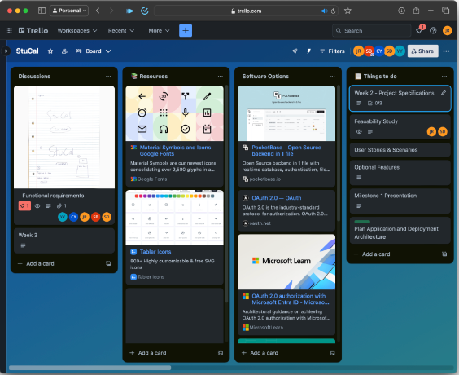

Technical
Teams Experience
Many of the developers have experience coding in the past.
Technologies used:
HTML, JS, CSS, VScode, Trello, Github.
Google Services
Hosting the site: Github pages or AWS
Database: Firebase
07
Notes:
- Yuki
Many of the developers have experience coding in many languages E.g. js , java, python,HTML
Additionally, we have developed skills through internships and industry experiences during the break.
So we have sufficient technical expertise to develop the product at a high standard.
To develop the software here are some services and apps we will use:
AWS - Hosting
Firebase - Database (backend)
Html etc - Front end design

Slide 8




Resource & Finance
For streamlined project management we have planned to use a blend of tools. Facebook Messenger will serve as our platform for group communication. In addition, Trello will be out project management software as its Kanban Board feature will help to enhance our workflow.
In terms of the project’s finances, we’re planning to operate within the constraints of the free tier limits offered by AWS. Nevertheless, we've allocated a contingency budget of up to $5 to address any potential overrun in expenses.
Messenger
08
Notes:
James
Trello for project management its Khanban Board feature is helpful
Messenger for group communication
Github for our source control
AWS for deployment with the goal of staying within the free tier but budgeting $5 in case we overshoot

Slide 9
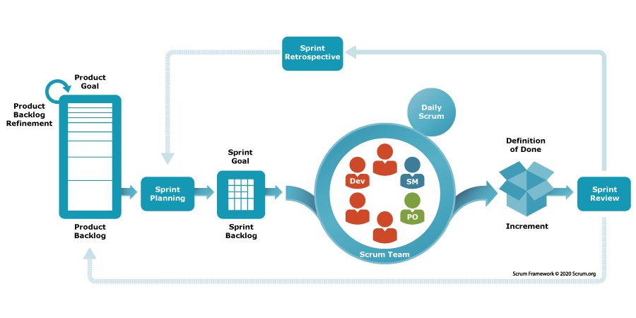
Operational
Software Delivery
Will the software be accepted by the client’s current environment?
On phone, tablet, PC, etc. Make sure the design is responsive to different screens and browsers
Make it easy to use as a student at Otago
Will the team be able to meet regularly?
Scrum meetings Once per week on Mondays
Sprints (2 week sprints)
09
Notes:
Yuki
The software will be developed to be used via web browsers and in the future, potential development to mobile apps.
To ensure the software will be developed in time, We run weekly scrum meetings every Monday makes sure everyone's on the same page, as well as Sprints every 2 weeks. So the software will never be at a critical breaking point. (Always working)

Slide 10
Project Schedule
01.
Milestone 01: Planning and Feasibility Study
05.
03.
INFO310 Examination
Milestone 03: Minimum Deliverable
The final exam will be 3 hours long and worth 50% of the course mark. It will contain questions from material covered in the lectures, tutorial/labs and experiences
Ensuring the team has a solid plan on what needs to be developed. This includes software requirements, estimations, and models.
Ensuring that the teams implement the most important functionalities of the software.
02.
04.
Milestone 02: Prototyping with Database
Final Software Deliverable
Ensuring that the team implements one of the most important steps in software development: the communication between software and a database
May 24th at 5pm is the deadline for the final deliverable. With this includes a presentation and demonstration of the final product.
10
Notes:
Cyrus
Only say the titles of the timeline

Slide 11
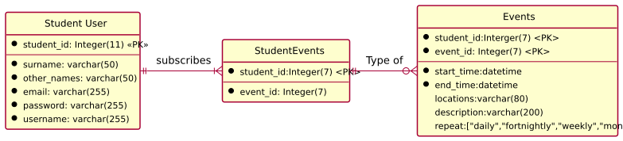
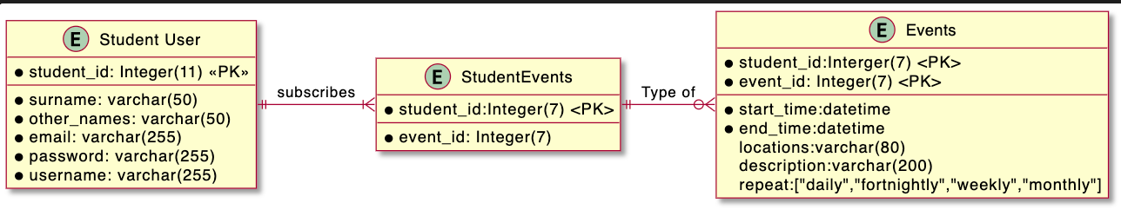
Preliminary Models
System domain model
11
Notes:
-James
Students can subscribe to many events if they wish.
Student users create events which can either be university related or public events, and can be toggled.
Events can be:
- University career events
- Group study sessions - members invited
- Personal events: classes and todos

Slide 12
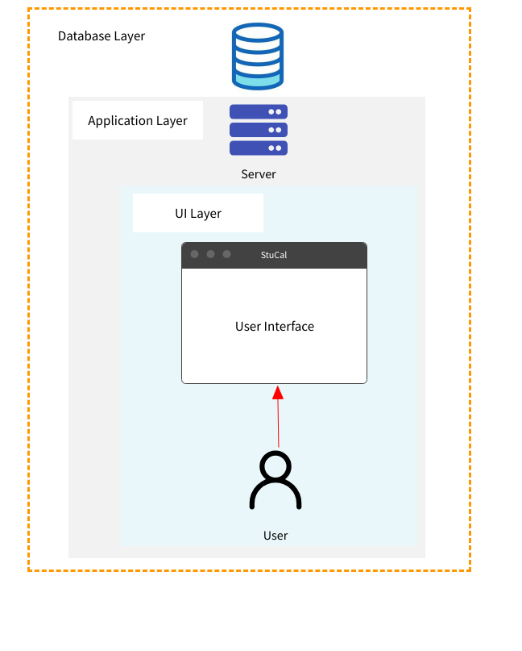
Preliminary Models
System architecture model
12
Notes:
Shreya -
- This is a preliminary model for the system architecture for StuCal.
- In the UI layer, the student who is a user of StuCal, will access information through the user web interface.
- To access the information, the interface functions, the processes are then passed to the server.
- The server accesses the data from the Firebase Database which is then sent back through the server to the user interface.

Slide 13
Home
Service
About Us
Contact
Thank
You
13

